Slide 1

Bangladesh Army University of Science & Technology (BAUST), Saidpur
Department : Computer Science & Engineering
Course Code : CSE2200
Course Title : Software Development Project II
Submitted By :
Submitted To :
Student Name : Nishat Tasnim Khushi
ID : 180201085
Batch : 8th
Level : 2 Term : II
Section :B
Date of Submission :29/11/2020
Teacher Name : MD. Toukir Ahmed
Designation : Lecturer

Slide 2
OUTLINE
Title
Project name
Introduction
Objective
How to play tic tec toe
Winning Combinations in game
Game output
Future work
Conclusion
reference

Slide 3
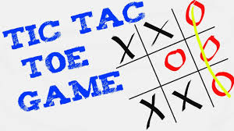
Project Name:
TIC TEC TOE GAME IN C++

Slide 4
Introduction
Tic-Tec-Toe(or Noughts and crosses, X and O) is a pencil and paper game for two players, X and O, who take turns marking the spaces in 3*3 grid.
The player who succeeds in placing three respective marks in a horizontal, vertical, or diagonal row wins the game.
This program is a game program, Tic-Tec-Toe. Most of us have played this game in school days, we have make a c++ program on it. Rules for tic-tec-toe-game is simple enough that we don’t need an elaborate analysis of game configurations.
Despite being a simple game, the basic all principles shown here can be applied to more complicated games such as checkers, go and even chess.

Slide 5
Objective
4 major part of my program.
1. char type global variable.
2.Checkwin Function.
3. Board Function.
4.Main Function

Slide 6
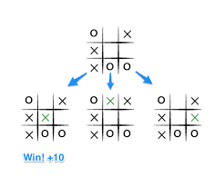
How to play Tic Tec Toe game:
Some guiding steps to play the game are:
The game is played between two players
Both players choose their respective symbols to mark
Player 1 stars the turn by placing his/her symbol on the empty squares
Then player 2 marks the turns by placing his/her symbols on the empty squares
Both players make their turns alternately
If any player gets the three respestive symbols in a horizontal, vertical or diagonal row wins the game.

Slide 7
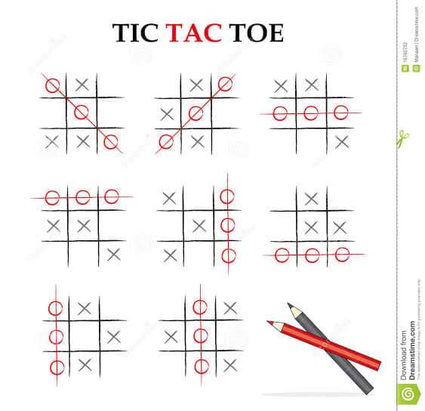
Winning Combinations in game:
In a Tic-Tec-Toe game there are 8 possibilities to win the game. The possibilities are getting the three combinations horizontally, three combinations vertically or two combinations diagonally as shown in the figure below. Hence, the easiest way to find the way to determine the winner of the game is to check for these eight combinations as the game goes on.

Slide 8
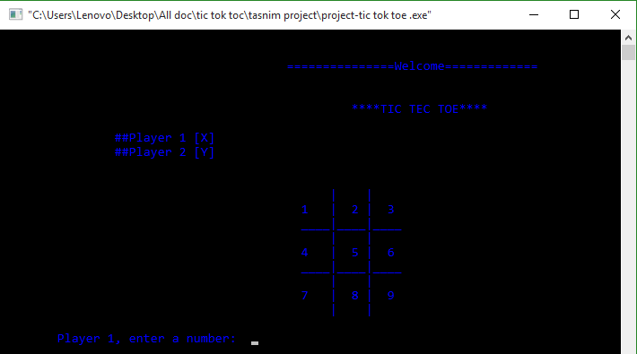
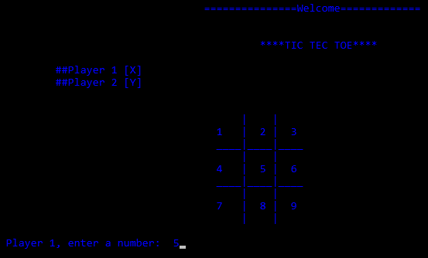
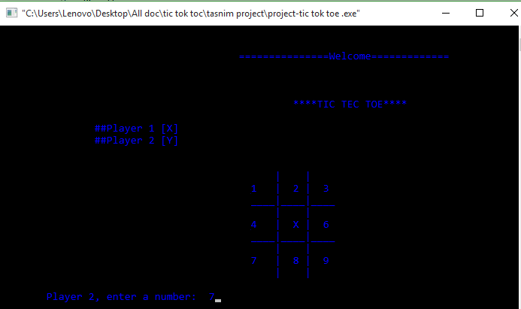
GAME OUTPUT
GAME START
Player1,enter the number
Player2,enter the number

Slide 9
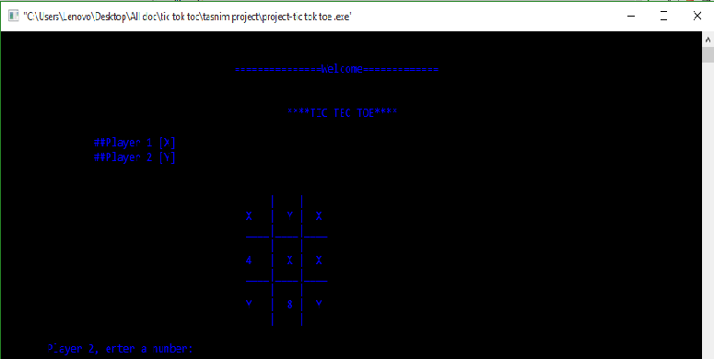
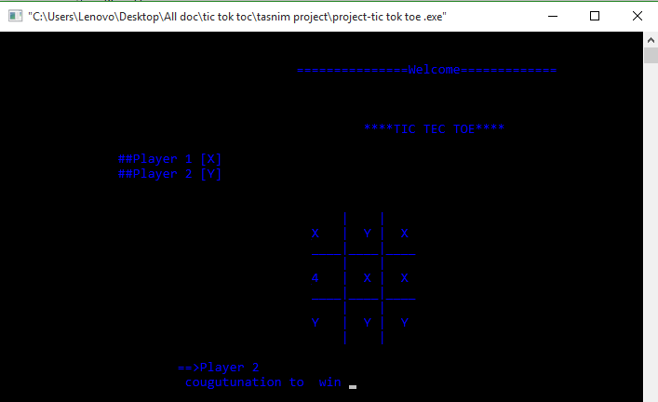
GAME OUTPUT
Game running
Player2 win

Slide 10
TIC TEC TOE
In future in Android application development we would like to learn the OpenGI 2D graphics which can be implements in the applitation which will improve the working and presentation of the application.
Also we would like to implement a 4*4 board game.
Future Work

Slide 11
TIC TEC TOE
In the end we would like to conclude that my aim to make this project was to research in the field of Android Application development and implementation of Artificial Intelligence by developing the logic for the game. Some scope of improvements are also there in the project which will rectified in the future advancements of the project. We would like to thank all those who have helped us and contributed in making of this project.
Conclusion

Slide 12
TIC TEC TOE
We use C++ programming language. And we use codeblocks, which is open source IDE for writing this project in C++.
Complete Reference of C++
Teach Yourself C++ Herbert Schidt
https://www.tutorialspoint.com
www.Google.com
And my past experience.
Reference

Slide 13

Visit my github link for code :
https://github.com/nishat12319/Project-TIC-TEC-TOE

